Slide 1
Process Management
Course Instructor
Anam Akbar

Slide 2
Process Management
Process
A series of actions or steps taken in order to achieve a particular end.
OR
The term process refers to an executing set of machine instruction.
Entities
Static entity
The instructions are the static entity, They exist on paper , in a file or even as a conceptual idea in the mind of an individual.
Dynamic entity
Set of instructions brought to life.
Performing actions as prescribed by the code.

Slide 3
Process Management
Process is associated with
Code
Its data
The operating resources allocated to it, and
One or more threads of execution.
THREADS
A thread is a flow of execution through the process’s code with its own program counter, system registers, and stack.

Slide 4
Process Management
Operating system can be classified as one of three types of systems:
Single process- single threaded
Multi process – single threaded
Multi process- Multi threaded
Single process- single threaded→
- one process can execute at a time.
-once a process is allocated to the CPU, that process runs to completion before any other process can execute.
- DOS is an example of a single process –single threaded operating System.

Slide 5
Process Management
Multi process – single threaded
Multiprocessing systems are far more practical.
They allow users to perform multiple concurrent task and they make more efficient use of computer resources.
CPUs execute much faster than I/O devices.
Millions of instructions can be executed in the time it may take to satisfy a single I/O request.
Multiprocessing system allow the CPU to be shared by multi processes.
The system interleaves the execution of processes, allowing each one the opportunity to periodically use the CPU.

Slide 6
Process Management
Multi process – single threaded
If one process is idle, waiting for an I/O request to be satisfied, another process not waiting for I/O may be allocated to the CPU. With enough memory and careful tuning, CPU utilization approaching 100% can be achieved.

Slide 7
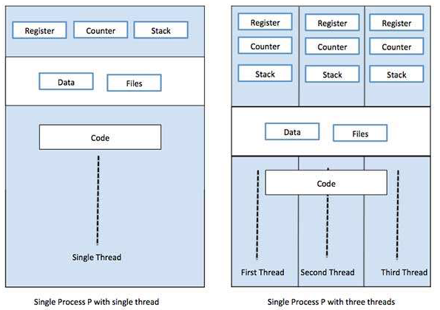
Process Management

Slide 8
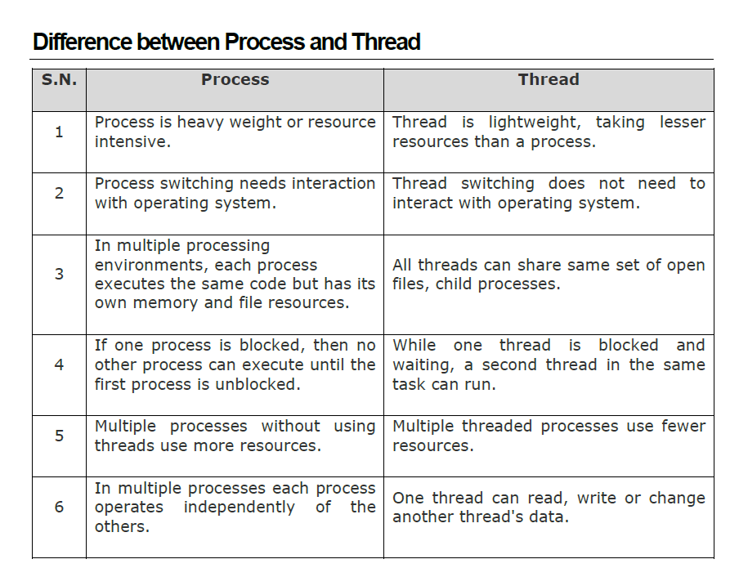
Process Management

Slide 9
Process Management
Types Of Threads(will discuss later)
User-level Threads
User managed threads
Kernel level Threads
On an Operating system core, OS managed threads acting on Kernel.

